Slide 1
Sorting Algorithms
Muhammad Abdulkariim

Slide 2
Introduction to Sorting Algorithms
Definition: Sorting algorithms are methods to rearrange elements in a list or array in a specific order (ascending or descending).
Importance: Used in databases, search algorithms, and data processing.
Common Sorting Algorithms: Bubble Sort, Selection Sort, Insertion Sort, Merge Sort, Quick Sort, etc.

Slide 3
Bubble Sort
Approach:
Compare adjacent elements and swap if they are in the wrong order.
Repeat until the list is sorted.
Time Complexity:
Best Case: O(n) (already sorted)
Average Case: O(n²)
Worst Case: O(n²)
Space Complexity: O(1) (in-place sorting)

Slide 4
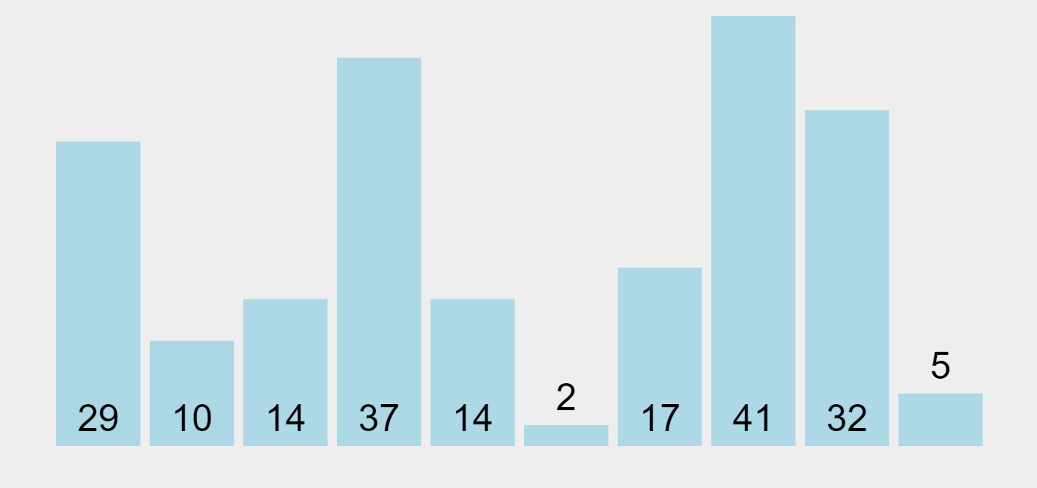
Bubble Sort

Slide 5
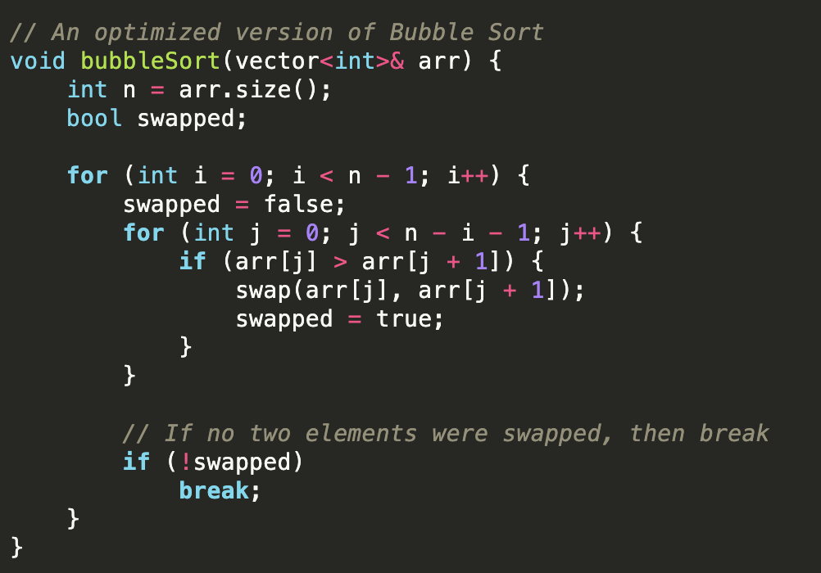
Bubble Sort

Slide 6
Selection Sort
Approach:
Divide the list into sorted and unsorted parts.
Repeatedly select the smallest (or largest) element from the unsorted part and swap it with the first unsorted element.
Time Complexity:
Best Case: O(n²)
Average Case: O(n²)
Worst Case: O(n²)
Space Complexity: O(1) (in-place sorting)

Slide 7
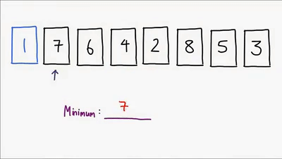
Selection Sort

Slide 8
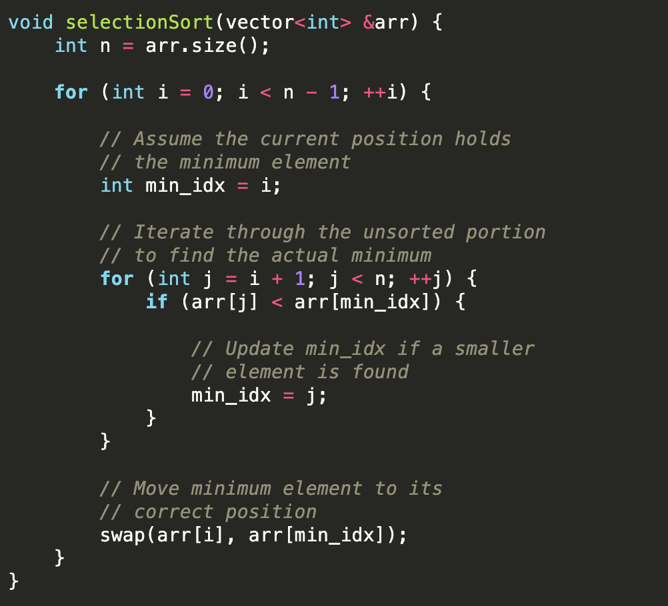
Selection Sort

Slide 9
Insertion Sort
Approach:
Build the sorted list one element at a time.
Take each element and insert it into its correct position in the sorted part of the list.
Time Complexity:
Best Case: O(n) (already sorted)
Average Case: O(n²)
Worst Case: O(n²)
Space Complexity: O(1) (in-place sorting)

Slide 10
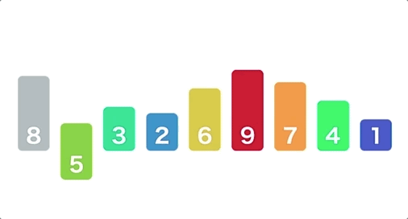
Insertion Sort

Slide 11
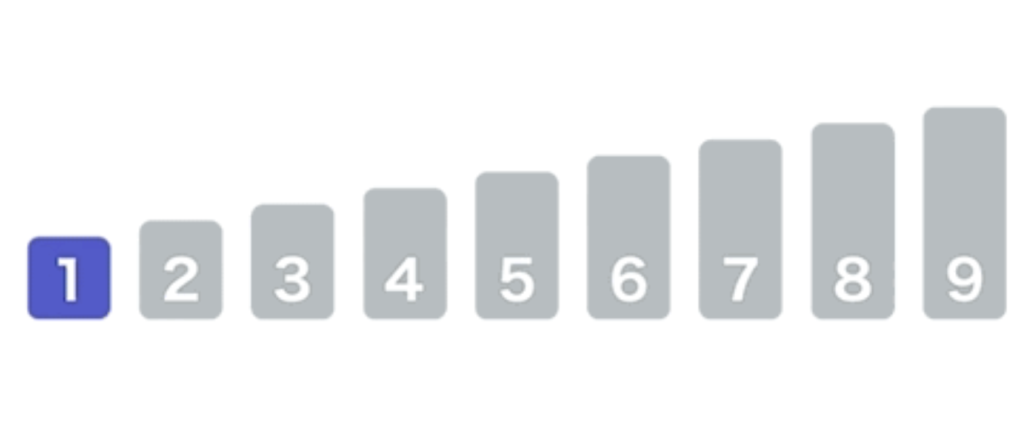
Insertion Sort

Slide 12
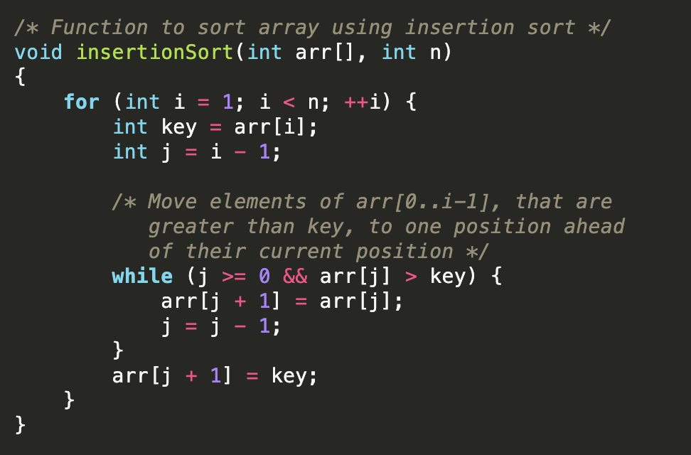
Insertion Sort

Slide 13
Merge Sort
Approach:
Divide the list into two halves.
Recursively sort each half.
Merge the two sorted halves.
Time Complexity:
Best Case: O(n log n)
Average Case: O(n log n)
Worst Case: O(n log n)
Space Complexity: O(n) (requires additional space for merging)

Slide 14
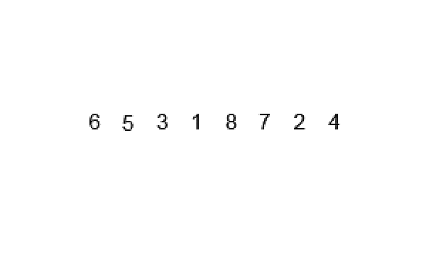
Merge Sort

Slide 15
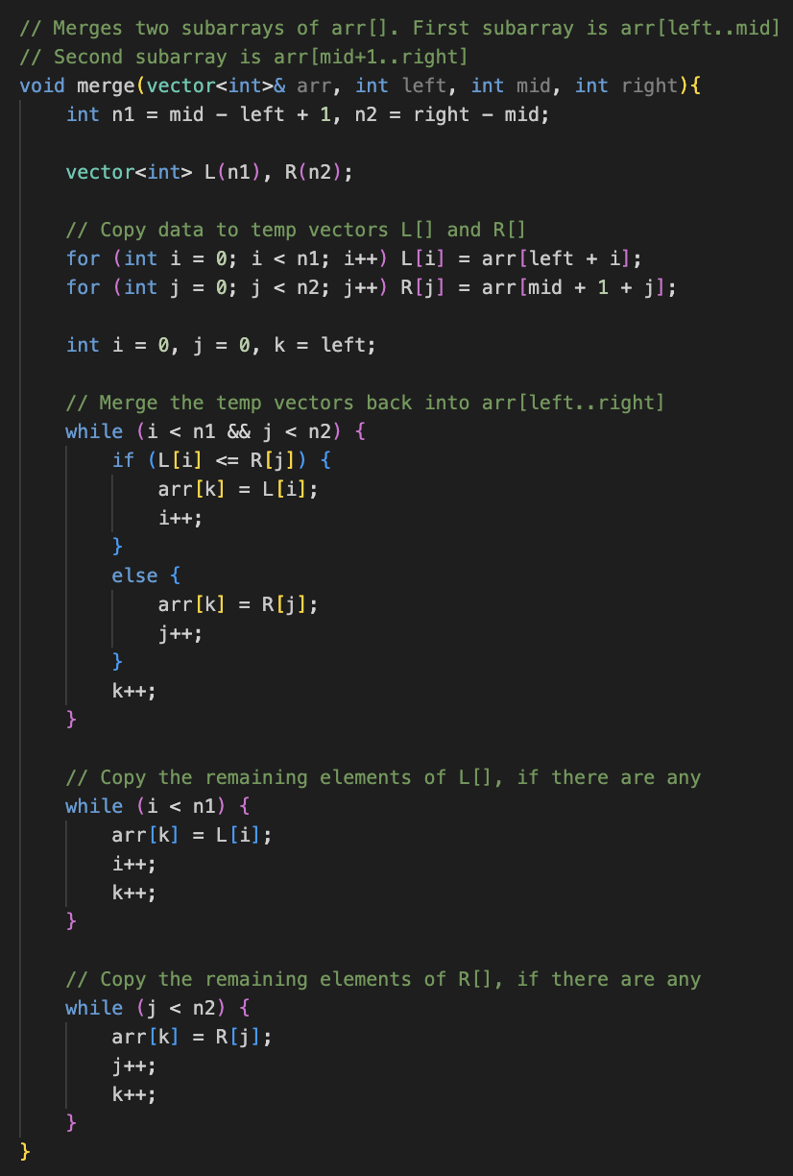
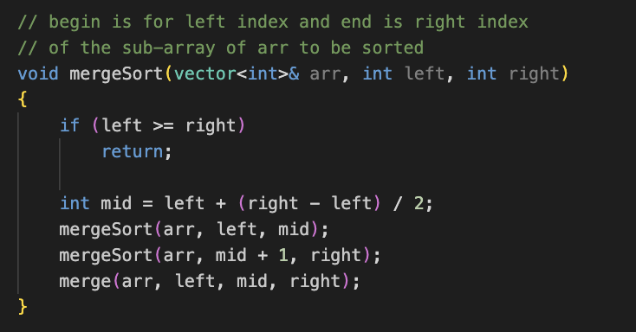
Merge Sort

Slide 16
Quick Sort
Approach:
Choose a pivot element.
Partition the list into elements less than the pivot and elements greater than the pivot.
Recursively sort the partitions.
Time Complexity:
Best Case: O(n log n)
Average Case: O(n log n)
Worst Case: O(n²) (if pivot selection is poor)
Space Complexity: O(log n) (due to recursion stack)

Slide 17

Quick Sort

Slide 18
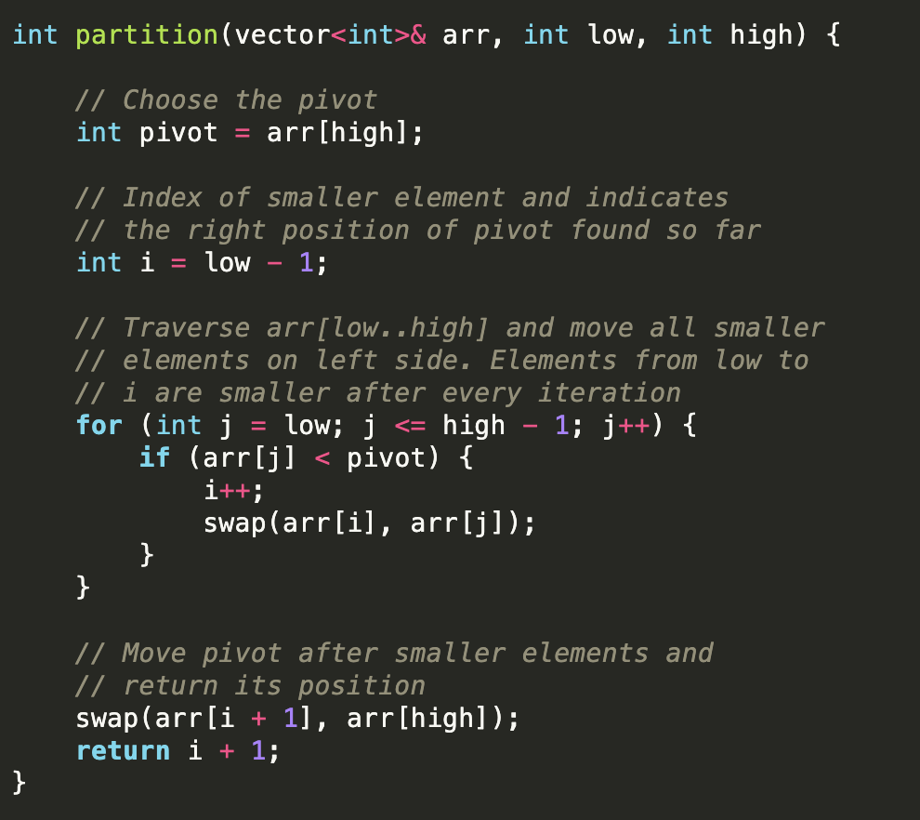
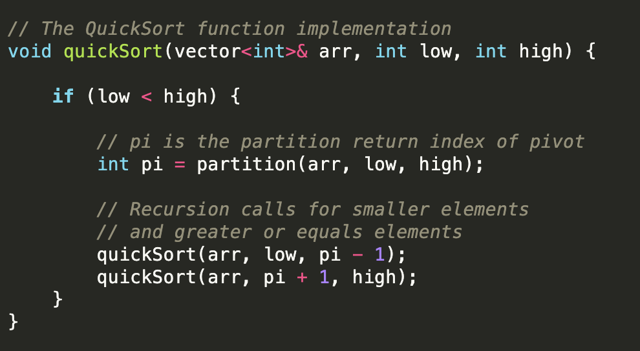
Quick Sort

Slide 19
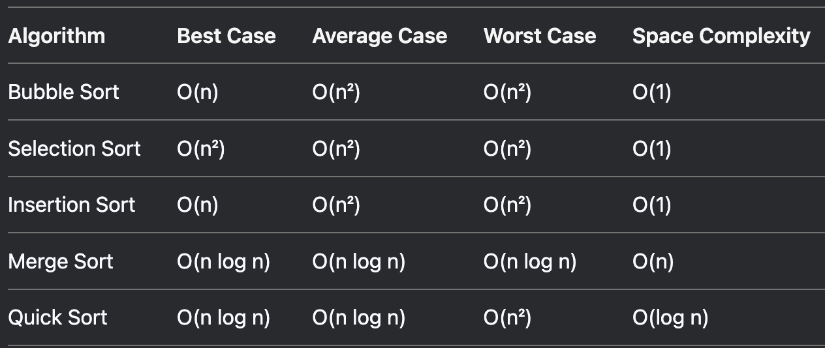
Complexity Comparison

